Slide 1
What is Data Manipulation
Data manipulation is the process of modifying, structuring, formatting, or sorting through data in order to facilitate its usage and increase its management capabilities.
Data manipulation methods are frequently employed by website owners to extract and view specific information from their web server logs. That allows for watching their most popular pages, as well as their traffic sources.
Consider the process of interrogating public financial or legal databases. Data manipulation provides the means for the credit analysts to extract only the relevant data and use it in other documents or correlate it with information from other sources.

Slide 2
String Methods
Concat -Concatenates the string representations of two specified objects Expression: String.Concat (VarName1, VarName2)
Contains-Checks whether a specified substring occurs within a string. Returns true or false.Expression: VarName.Contains (“text”)
Format-Converts the value of objects to strings (and inserts them into another text)Expression: String.Format(“{0} is {1}”, VarName1, VarName2)
IndexOf-Returns the zero-based index of the first occurrence of a character in a String.Expression: VarName1.IndexOf(“a”)
Join-Concatenates the elements in a collection and displays them as String.Expression: String.Join(“|”, CollVarName1)
Replace-Replaces all the occurrences of a substring in a string.Expression: VarName.Replace (“original”, “replaced”)
Split-Splits a string into substrings using a given separator.Expression: VarName.Split(“|“c)(index)
Substring - Extracts a substring from a string using the starting index and the length.Expression: VarName1.Substring(startIndex, length)

Slide 3
List
Lists (or List<T>, as you will encounter them) are data structures consisting of objects of the same data type (for example string or integer). Each object has a fixed position in the list; thus, it can be accessed by index. While arrays are fixed-size structures for storing multiple objects, lists allow us to add, insert and remove items.
Lists can store large numbers of elements - names, numbers, time coordinates and many others. Lists provide specific methods of manipulation, such as:
Adding and removing items
Searching for an element
Looping through the items (and performing certain actions on each)
Sorting the objects
Extracting items and converting them to other data types.

Slide 4
UiPath Methods applicable to Collections
Add to Collection-Adds an item to a specified collection. It is equivalent to List.Add(). It can be used, for example, to add a new name to a list of company names.
Remove from Collection-Removes an item from a specified collection and can output a Boolean variable that confirms the success of the removal operation.
Exists in Collection-Indicates whether a given item is present in a given collection by outputting a Boolean as the result.
Clear Collection-Clears a specified collection of all items. One possible use is to empty a collection before starting a new phase of a process that will populate it again.

Slide 5
Dictionaries
Dictionaries (or Dictionary<TKey, TValue>, as you will encounter them) are collections of (key, value) pairs, in which the keys are unique. Think of the Address Book in your mobile phone, where each name has corresponding data (phone number(s), email).
Methods for Working with Dictionaries
Initialization -Just like in the example of Lists, Dictionaries have to be initialized.
Adding- VarName.Add(Key, Value) – adds an item to an existing Dictionary. Because Add does not return a value, use the Invoke Code activity.
Removing-VarName.Remove(Key) – removes an item from the Dictionary. It can be used in an ‘Assign’ activity.
Retrieving
VarName.Item(Key) – returns the Dictionary item by its key
VarName.Count – returns an Int32 value of the number of Dictionary items
VarName.ContainsKey(Key) – checks if the item with the given key exists in the Dictionary and returns a Boolean result
VarName.TryGetValue(Key, Value) – checks if an item with a given key exists in the Dictionary and returns a Boolean result and the value if found

Slide 6
Regex Builder
Regular Expression (REGEX, or regexp) is a specific search pattern that can be used to easily match, locate and manage text. However, creating RegEx expressions may be challenging.
Methods in UiPath that use the RegEx builder
Matches-Searches an input string for all occurrences and returns all the successful matches.
IsMatch-Indicates whether the specified regular expression finds a match in the specified input string.
Replace-Replaces strings that match a regular expression pattern with a specified replacement string.
Typical uses of RegEx include:
Input validation
String parsing
Data scraping
String manipulation

Slide 7
Practice 1 - Lists
Sort the List and Print 3 Values
Given an input list of countries please sort the list and print the first 3 values in descending order.
Note: Please use this value for the List initialization: new List(of String) from {"Germany", "Spain", "Japan", "Brazil", "India", "China"}.

Slide 8
Practice 2 - Dictionaries & Integers
Calculate and print the number of victories of each Tour de France winner
Given an input dictionary containing a year and a name, please calculate the number of victories of each winner and print all the names of the winners with the number of corresponding victories.
Note: Initialize a dictionary of type (Int32, String) with the following value - New Dictionary(Of Int32,String) From {{2006,"Oscar Pereiro"},{2007,"Alberto Contador"}, {2008, "Carlos Sastre"}, {2009,"Alberto Contador"}, {2010, "Andy Schleck"}, {2011, "Cadel Evans"}, {2012,"Bradley Wiggins"}, {2013,"Chris Froome"}, {2014,"Vincenzo Nibali"},{2015,"Chris Froome"},{2016,"Chris Froome"},{2017,"Chris Froome"}, {2018,"Geraint Thomas"}}

Slide 9
Practice 3 - Extract Email Address
Extract the email address from a string (without using RegEx)
Given a string containing one email address, create a workflow to extract the email address without using regular expressions.
Note: For input please use a String variable with the following value “Please use the following address to contact me john.doe@localcompany.com, it's the company email"

Slide 10
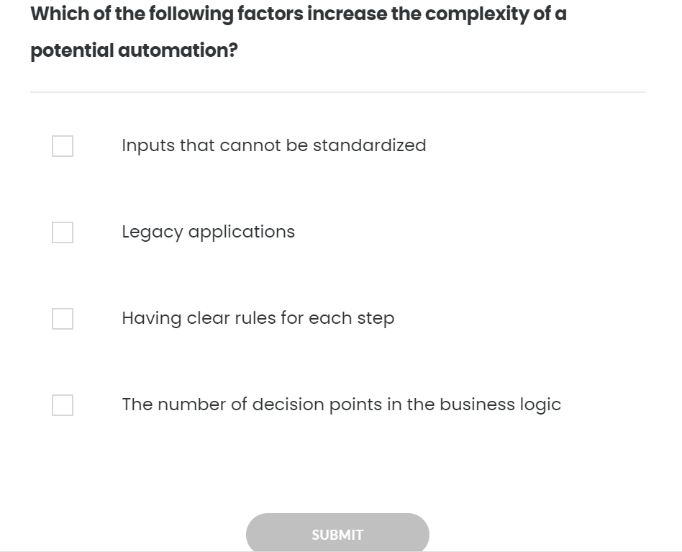
Quiz 01/10

Slide 11
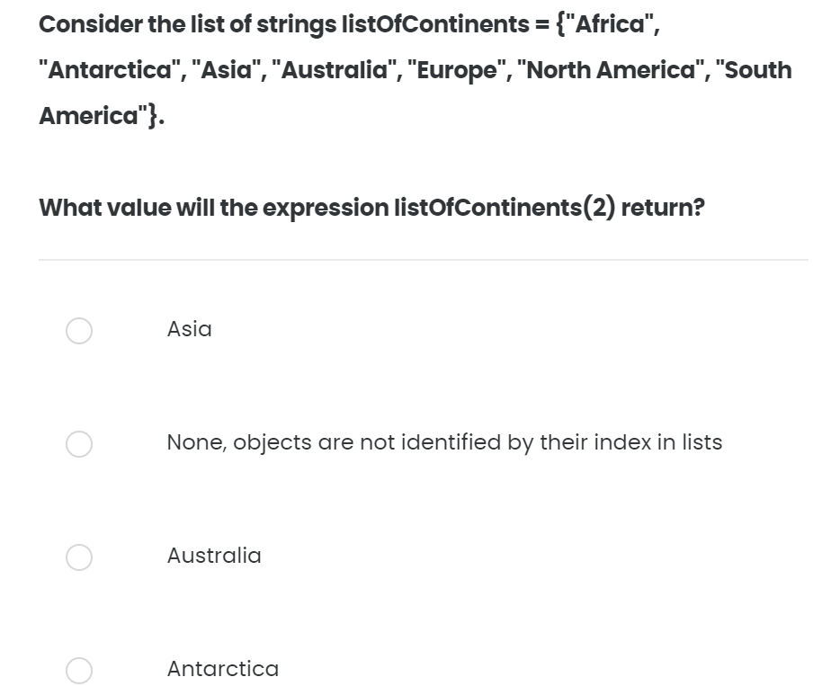
Quiz 02/10

Slide 12
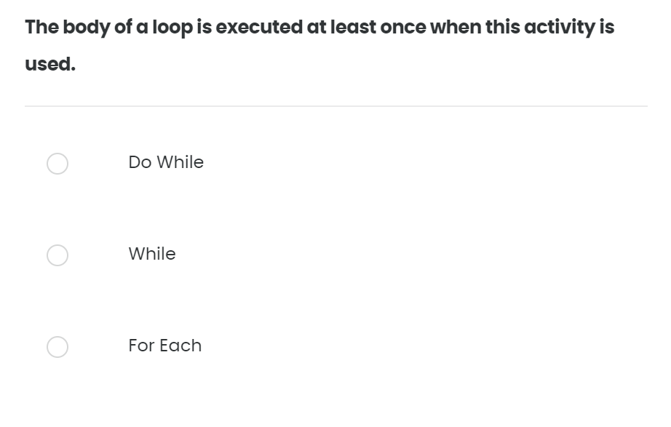
Quiz 03/10

Slide 13
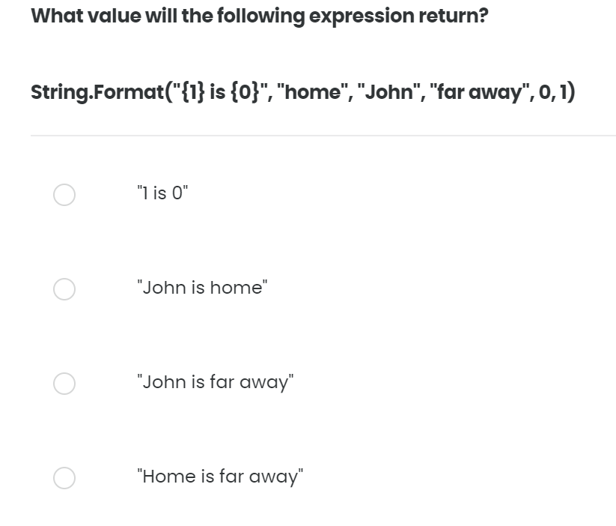
Quiz 04/10

Slide 14
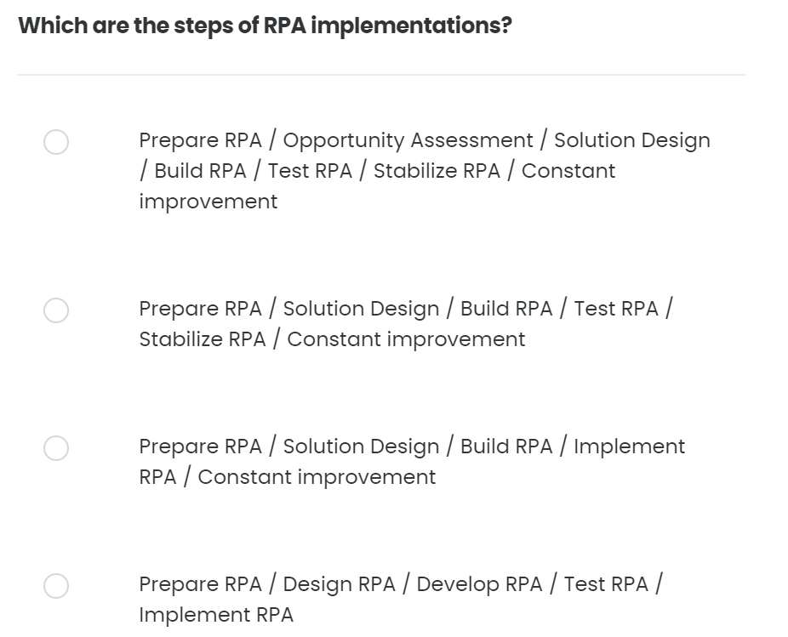
Quiz 05/10

Slide 15
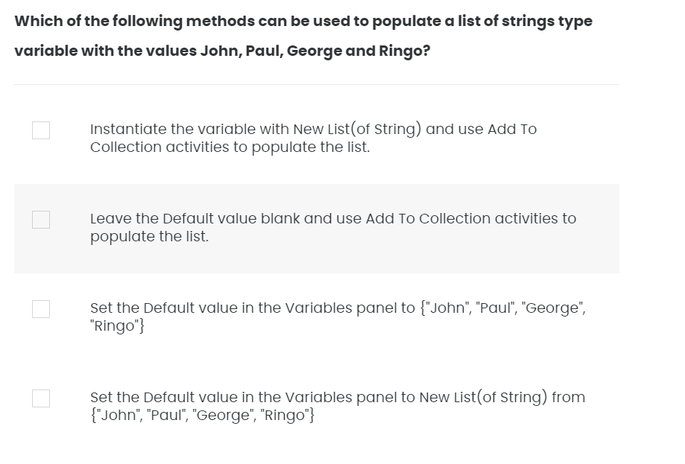
Quiz 06/10

Slide 16
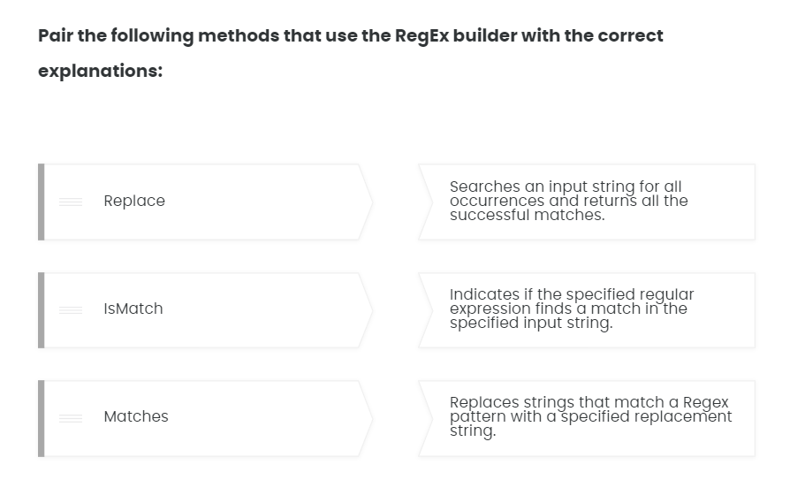
Quiz 07/10

Slide 17
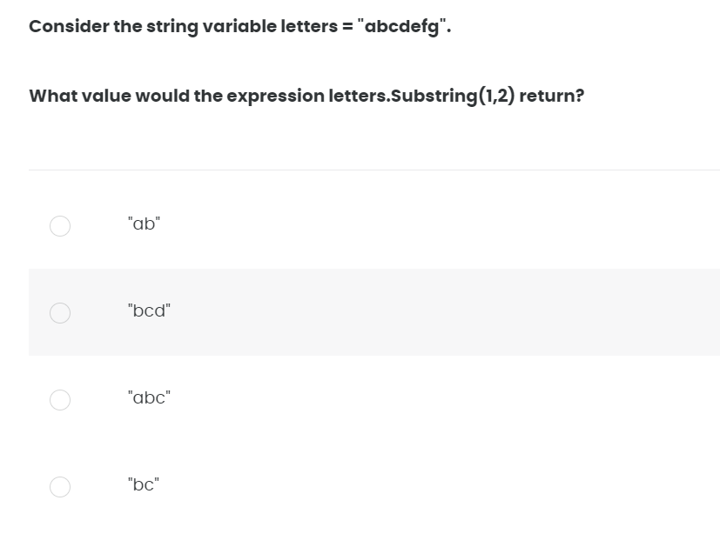
Quiz 08/10

Slide 18
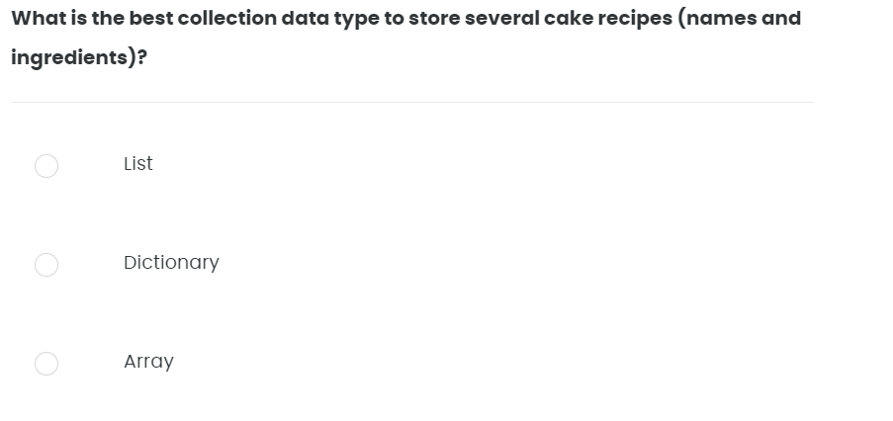
Quiz 09/10

Slide 19
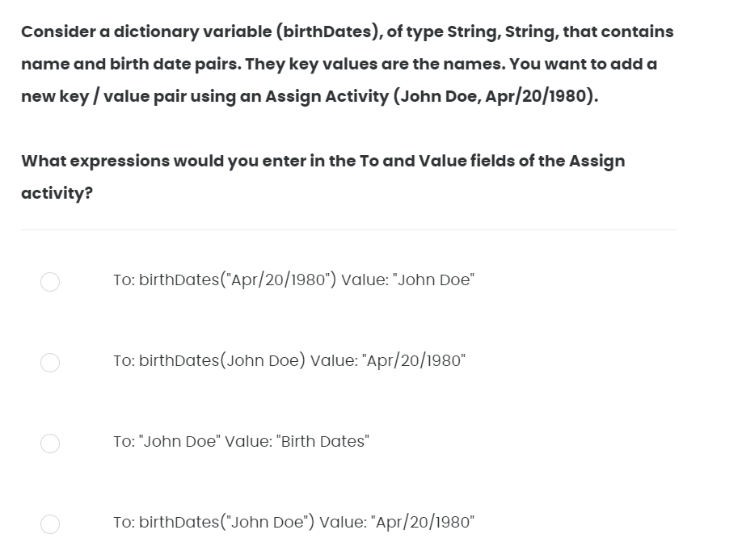
Quiz 10/10

